Slide 1
Open Source License Detection
Michael Znidarsic
MBC 638

Slide 2
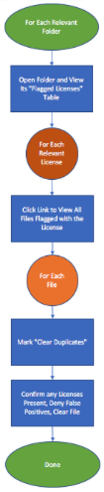
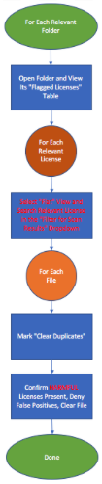
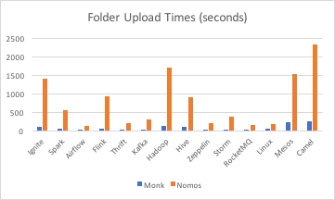
Open Source License Detection
Process Owner: Michael Znidarsic
Key Dates: 2/19 2/16 3/1
DEFINE
PAIN:
Clearing files of source code takes far too long.
POSSIBLE FACTORS:
Text Detection Tools
File Clearing Methodology
Business Rules
MEASURE
ANALYZE
Change Business Rules
SQL for Text Detection Accuracy
NEED BOTH!
IMPROVE
Statistically significant improvement at 0.01 alpha!
Improvement consistent, 0.9687 correlation between before and after times.
Time decrease factor: 0.47!
Folder | 1st Process
Ignite | 941
Spark | 848
Flink | 1094
Hadoop | 551
Zeppelin | 322
Hive | 224
NOMOS | MONK
SQL: ~2.5 | SQL: ~1.05
CONTROL
Changes to Business Rules and FOSSology methodology going forwards.

Slide 3
DEFINE
The Problem:
When Stairstep Consulting conducts software source code due diligence investigations, we are frequently given a quota of billable hours by the client. This is done not only to reach an agreement beforehand on the price of our investigation, but also to approximate the depth at which the report should operate. However, large or complicated source code packages frequently take so long to parse that we are faced with the decision of working extra hours pro bono or turning in a report that we feel may lack some important analytical details.

Slide 4
Process and Target
To find harmful licenses within source code, Stairstep Consulting uses the software FOSSology, which includes the text detection tools Monk and Nomos. These tools detect both harmful and harmless licenses, and do not have complete accuracy when they flag files for them. It is up to a trained consultant to go into the files flagged by these tools and verify the presence of (a) harmful license(s). This process is necessary, but time-consuming and potentially very inefficient.
Stairstep is targeting a ⅓ reduction in folder clearance time with this project.

Slide 5
MEASURE
A given project will typically include many folders. A folder is, of course, a wildly varying unit of measurement. A folder may have essentially no licenses in it, or tens of thousands of licenses. The same can be said for a folder’s file count. I will use paired and proportional (e.g. SQL) data to avoid this threat to the data’s relevance. I will time myself in clearing folders of source code from prominent open-source softwares with moderate amounts of licenses present in them, of which a smaller proportion are harmful, and afterwards examine the accuracy.
Continuous Data: Upload time per folder, clearance time per folder.
Discrete Data: False positive/negative flaggings per folder.

Slide 6
Data Stratification Table
Questions About Process
Stratification Factors (X Variables)
Measurements
How do the text detection tools used perform when it comes to false negatives? (accuracy)
Scan time
How do the text detection tools used perform when it comes to false positives? (efficiency)
Text detection tool(s) used.
False positives
Time to Clear Folders
Accurately
False negatives
Clicks
FOSSology view/setting methodology.
Screens / pages
How do the scan/upload times of the text detection tools compare?
Clearance time
(Output Y)
How do the scan times of the text detection tools compare?
Business rules.
Necessary? Value-add or not?
Clearance time
What business rules are unnecessarily taking up time?
Estimated Sample Size for Paired t-test:
6
How do the changes made to the process actually affect efficiency?

Slide 7
ANALYZE
While collecting time data, I discovered two main Root Causes of inefficiency through experience:
Established FOSSology “Scanner Count” method requires many more clicks and new pages/screens than another method (“Flat” View). It also has no external indicator of clearance, opening the possibility of wasting time on already cleared files.
Useless business rule of verifying all flagged licenses in a file containing a harmful one, including harmless ones.

Slide 8
Upload Times
It was clear that of the two text detection tools tested, Nomos (mean 10903 seconds) took far longer to analyze the sampled folders than Monk (mean 1121 seconds).
However, the SQL tests on the next slide show that both Monk and (especially) Nomos are required to achieve an acceptable level of accuracy, and therefore Nomos cannot be eliminated even though that would save a lot of time each project.
Clustered/Paired Bar Graph

Slide 9
SQL for False Negatives
Folder | Bad Licenses | Nomos | Monk
Ignite | 12 | 1 | 10
Spark | 14 | 1 | 14
Flink | 21 | 5 | 11
Hadoop | 6 | 3 | 3
Hive | 4 | 0 | 1
Zeppelin | 10 | 1 | 6
 | 67 | 11 | 45
 |  | DPMO | DPMO
 |  | 164179.1045 | 671641.791
 |  | SQL: ~2.5 | SQL: ~1.05
I measured the individual Sigma Quality Levels of the Nomos and Monk text detection tools to compare their efficacy. A harmful license present in the source code counts as one unit, and failure to flag one of those licenses counts as a defect.
Further study is needed for the SQL of using both together, but it must be (appreciably, based on experience) higher than Nomos’ surprisingly low 2.5. Using Monk alone is out of the question.

Slide 10
SQL for False Positives
Folder | Total Files | Nomos | Monk
Ignite | 13407 | 0 | 1
Spark | 4845 | 3 | 0
Flink | 8765 | 0 | 0
Hadoop | 14488 | 1 | 0
Hive | 6672 | 1 | 0
Zeppelin | 1323 | 1 | 0
 | 49500 | 6 | 1
 |  | DPMO | DPMO
 |  | 121.2121212 | 20.2020202
 |  | ~5.2 | ~5.6
Sigma Quality Level regarding false positives is less critical than for false negatives, and focuses on potential wastes of time. Any file in the source code could be flagged for an unlimited amount of licenses, so SQL had to be calculated with 1 defect = 1 file containing any number of erroneous flags, and the sample = all files scanned.
I was pleased to see the high SQL for false positives, indicating very little inefficiency.

Slide 11
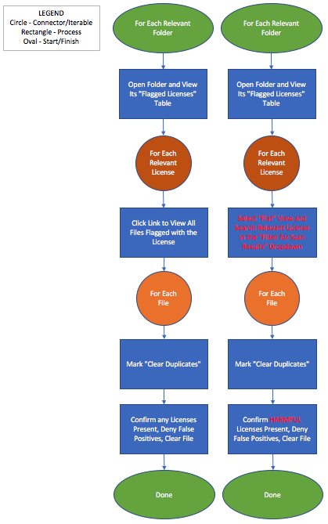
IMPROVE
Based on the two Root Causes discovered during the Analyze phase, I decided to implement a time-saving change for each of them. Changes can be seen in red on the chart to the right.
“Scanner Count” methodology will be replaced with the “Flat” view, which will decrease clicks, screens/pages to view, and double-checks.
Only harmful licenses are to be verified, time will not be wasted on harmless licenses.

Slide 12
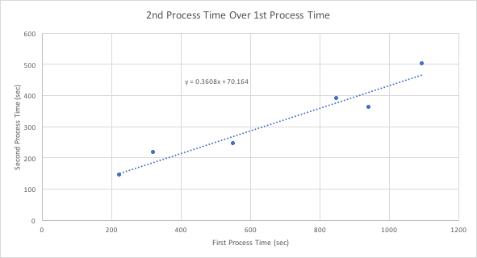
Before and After Time Data
Folder | First Process | Second Process
Ignite | 941 | 362
Spark | 848 | 389
Flink | 1094 | 501
Hadoop | 551 | 244
Zeppelin | 322 | 216
Hive | 224 | 145
Compared the time it took to verify the licenses in the sampled folders and clear them before and after improvement.
The improvement was consistent. Correlation between first and second process time was 0.9687, and the first process time explained 93.8% of the second. An LSRL yielded the equation y = 0.3608x + 70.164, and an F - stat of 0.00145015 showed its significance.

Slide 13
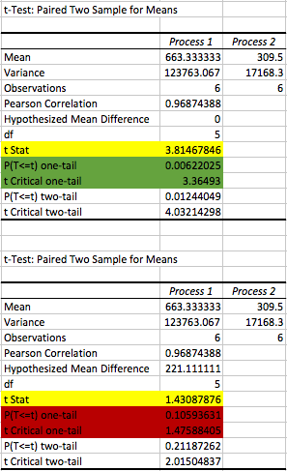
Did we improve? (paired t-tests)
Mean time to clear a folder decreased by a factor of 0.46658; sample mean decrease was better than goal.
Statistically significant improvement at 0.01 alpha! Rejected Ho: ud <= 0 in favor of Ha: ud > 0
Narrowly failed to reject null at 0.1 alpha that the time difference between processes was great than mean of 221.1111 (equivalent of the target decrease factor ⅓). Ho: ud <= 221.1111; Ha: ud > 221.1111
Great improvement, can’t quite confirm goal exceeded.

Slide 14
CONTROL
Monk and Nomos will continue to be used in conjunction, as neither is substantially impeding productivity with high rates of false positives and both have proven to often flag harmful licenses that the other failed to flag.
Clearing folders using FOSSology will be done using the Flat view, in which it is easier to avoid wasting time by checking the same files twice and also easier/faster to browse by license flagged than the former methodology (clicking the Scanner Count of each flagged license successively).
The practice of verifying non-harmful license flags within files that also contain harmful license flags adds no value and wastes time, so it will be discontinued moving forwards.

